Slide 1
SE 1 (Web Development Course)
Section 2 (HTML & HTML5)

Slide 2
Course outline
HTML
HTML5
CSS
CSS3
BootStrap
JavaScript
VUE JS
Node JS
MySQL VS MongoDB

Slide 3
HTML Language Summary in 5 minutes

Slide 4
Hypertext Markup Language (HTML)
HTML
Is the standard markup language for creating web pages
Describe the structure of a web page

Slide 5
HTML Language Rule
One rule for writing the HTML language which is based on </TAG>
Tags are written by two ways:
<> </>
<START TAG> Content </END TAG>
affects the content
<>
<START TAG>
Add to web page
Called empty tag
1
2

Slide 6
Common HTML terms
Elements
<h1> I’m HTML element </h1>
Tags
<h1> we’re tags </h1>
<a> because I </a>
<p> have brackets <p/>
<img src=“g.ipg”>
Attributes
<a href=“https://abc.com/”> you find me </a>
Property
<tagname style="property:value;">
<h1 style="color:red;"></h1>

Slide 7
HTML attributes
HTML attributes:
Give you more control over how your content is displayed. It allows you to align text or images, change the color of fonts, set the width of a table and much more.
All elements can have attributes
Are always specified in the start tag
Syntax: name = “value”
Some examples:
href of <a> link tag : specifies the URL
<a href=http://abc.com> click here </a>
src of <img> tag: specifies the image location
<img src=“flower.jpg”>
3. …

Slide 8
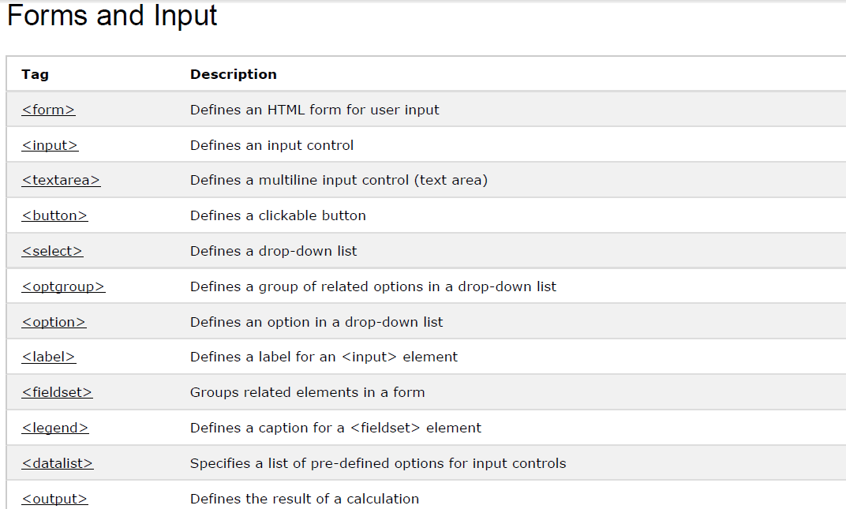
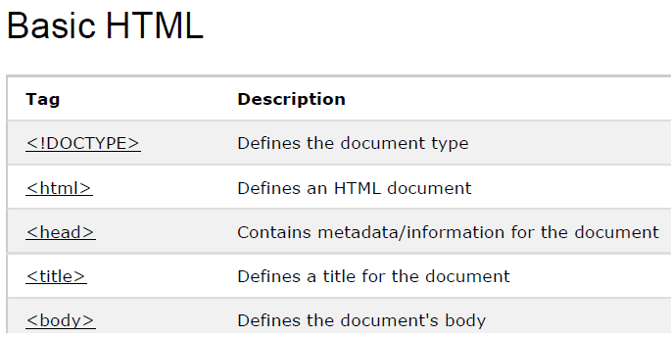
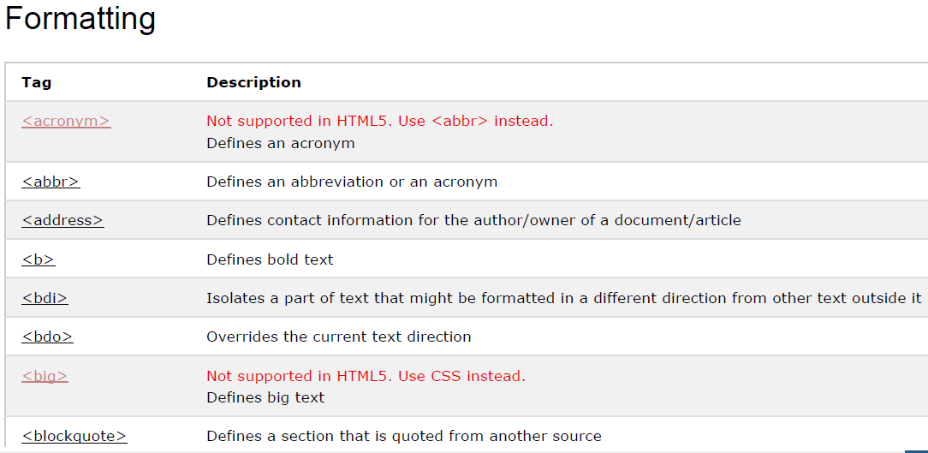
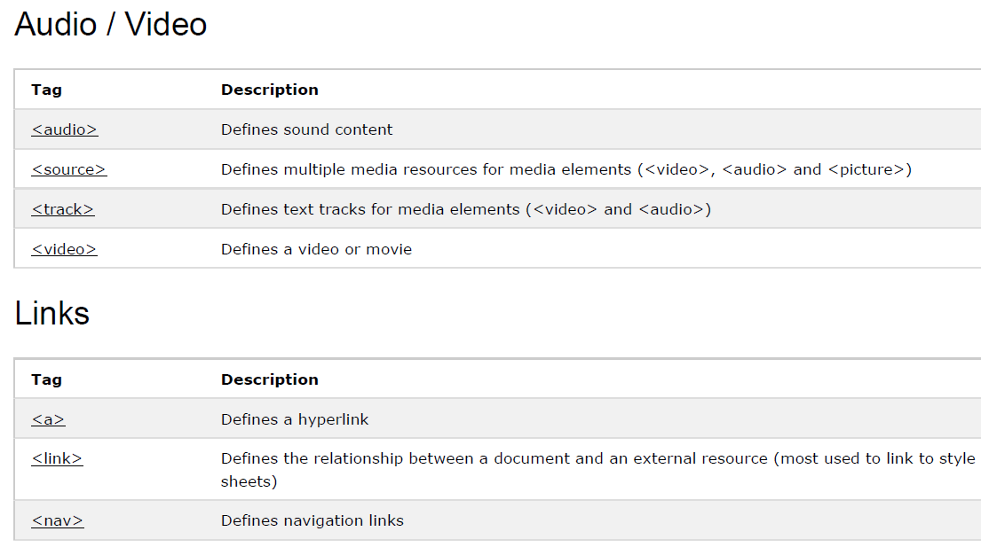
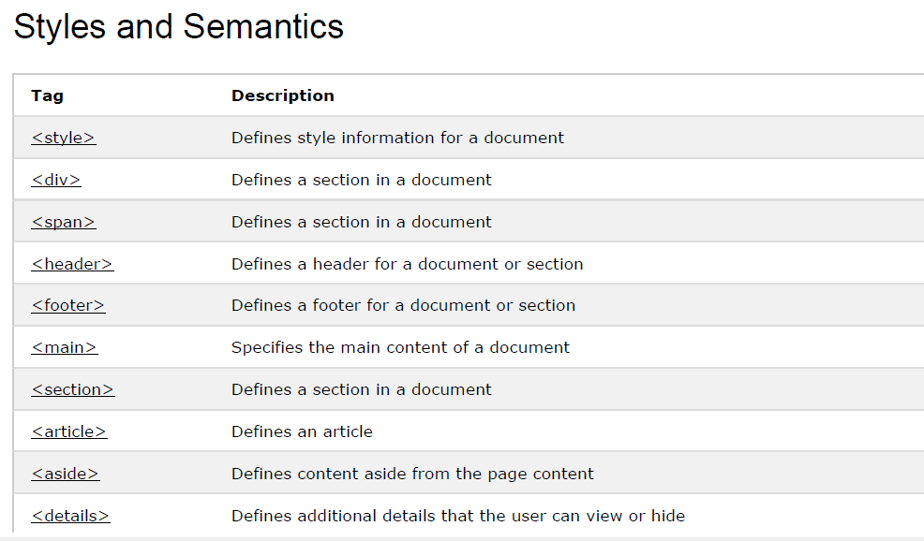
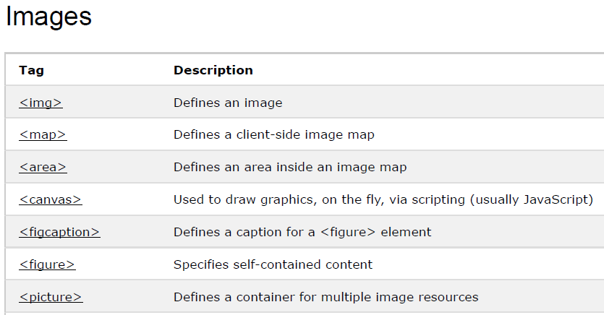
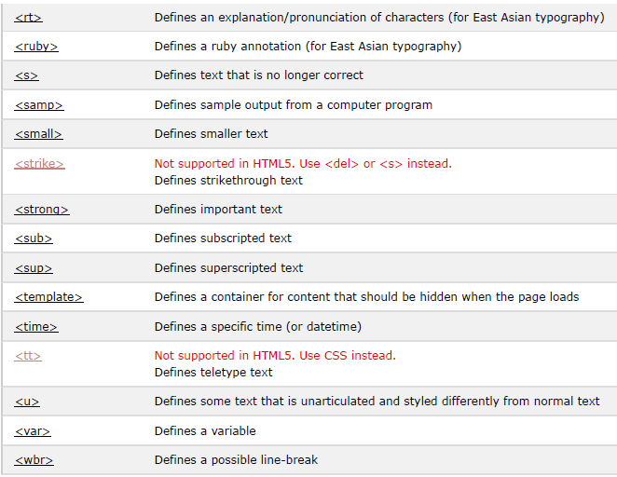
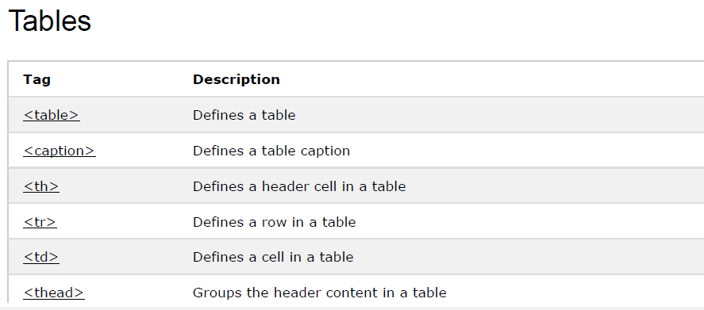
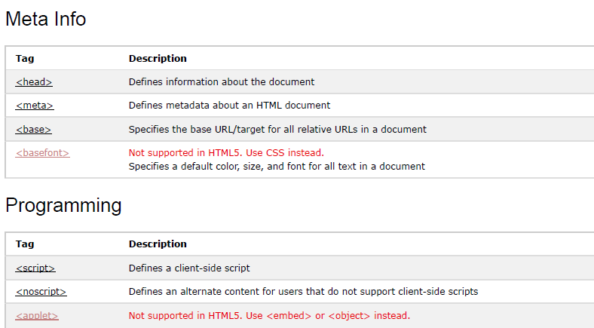
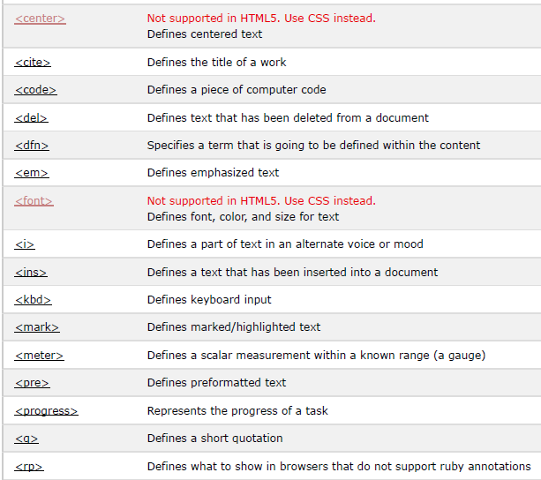
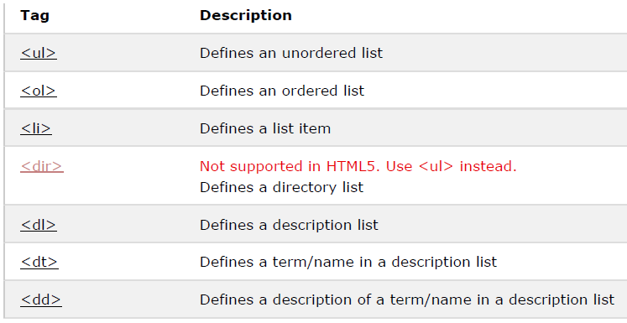
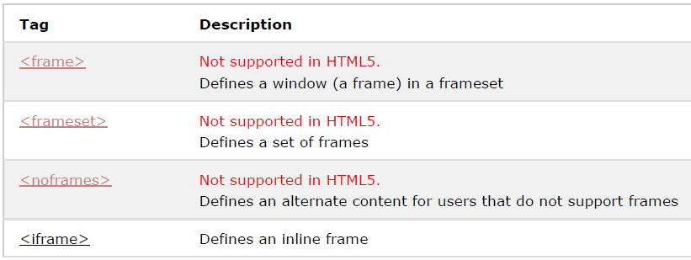
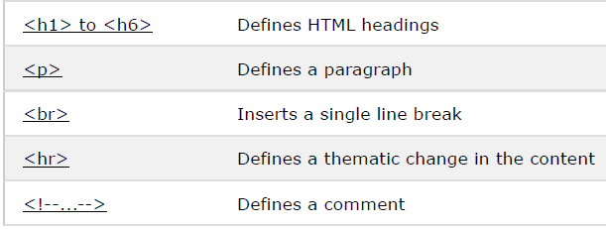
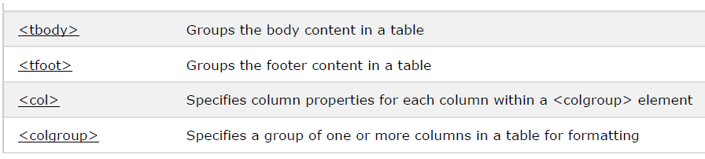
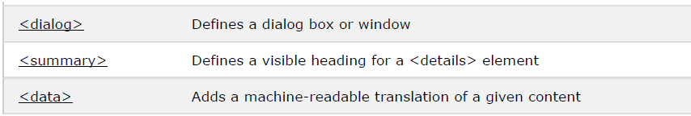
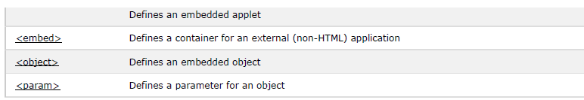
Complete HTML 5 Tags
Lists
Frames

Slide 9
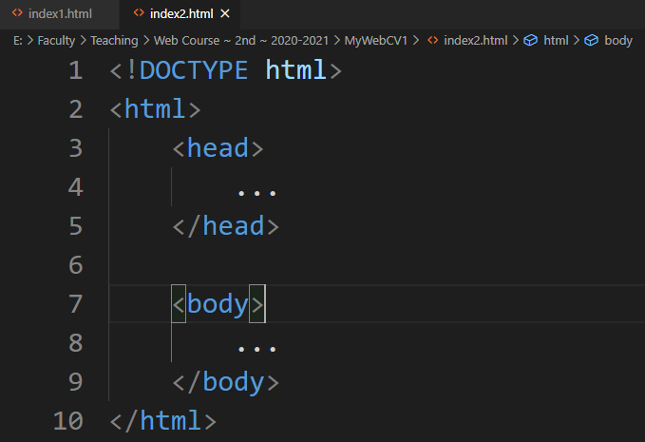
HTML document structure
Specify for the browser:
(1) Document type (HTML )
(2) HTML version you use
Represents the root of an HTML page
Contains the meta information for the web page
will have all the visible content of the page

Slide 10
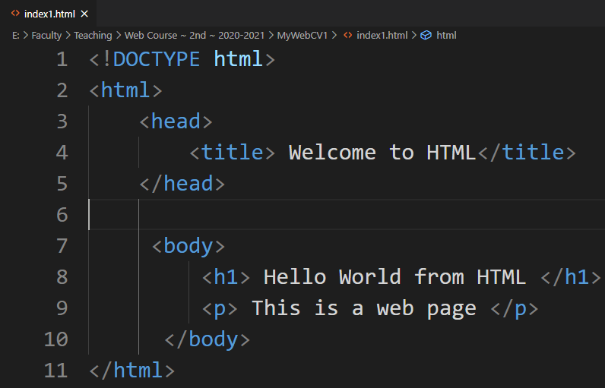
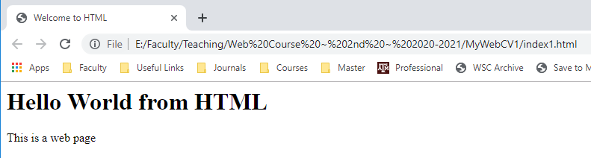
Simple example 1

Slide 11
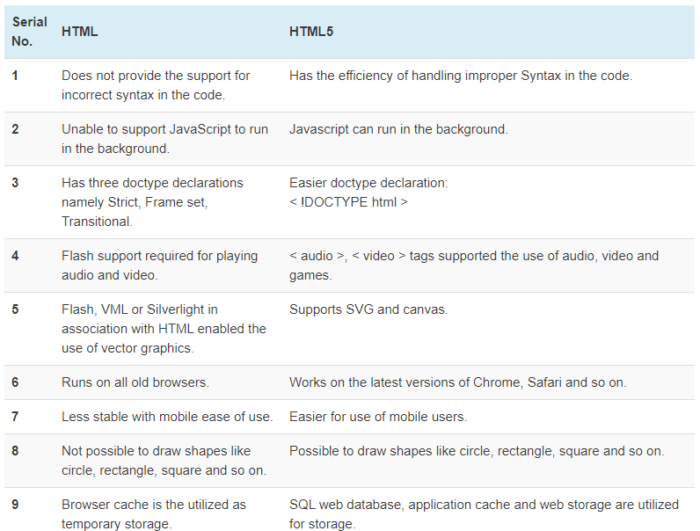

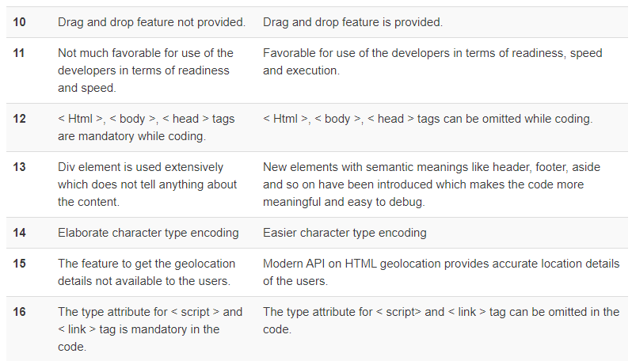
HTML vs. HTML 5
HTML 5
is the latest version of HTML and has a lot of improved features.
has introduced a bunch of new elements and attributes.
provides support to CSS3, video, audio, and graphics.
Here, differences between HTML5 and HTML 4.01, commonly called HTML now.

Slide 12
Now, let us know & practice more about HTML tags

Slide 13
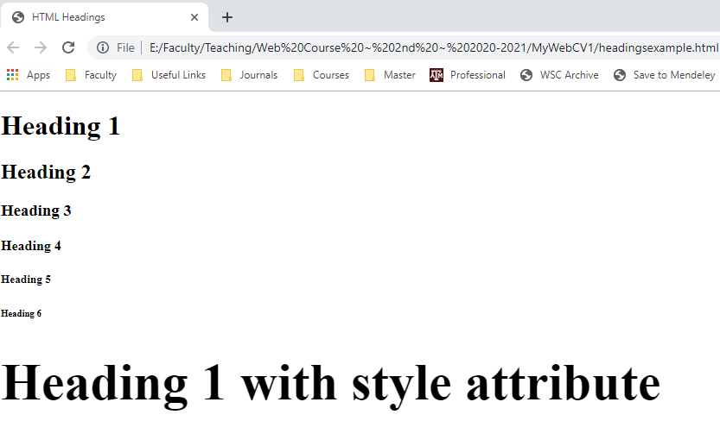
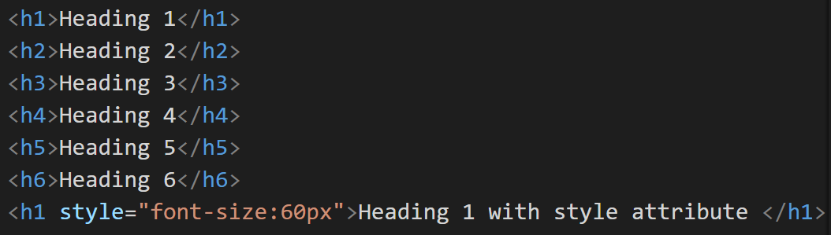
Headings tags
Are titles or subtitles which you want to display on the webpage
Are defined from <h1> to <h6> tags
<h1> tag is used for the main headings, then <h2> for less heading and so on.
Are have default size but you can control the font size using the style attribute
Example:
Use the same html file or create another one
inside the <body> tag write the following code

Slide 14
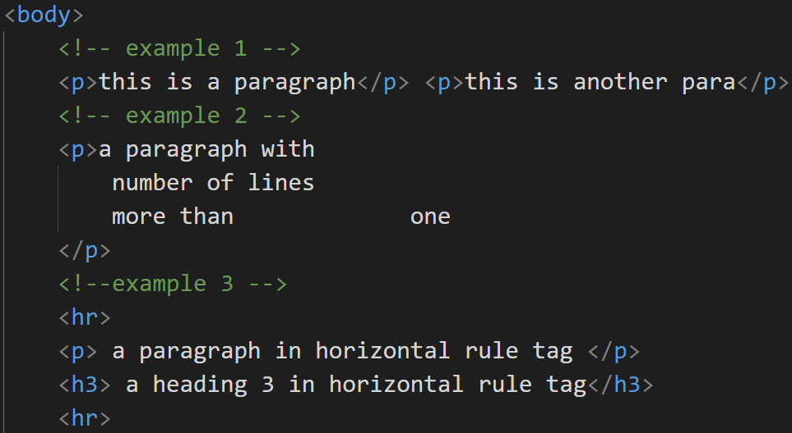
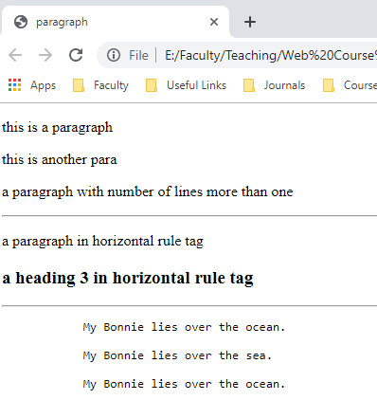
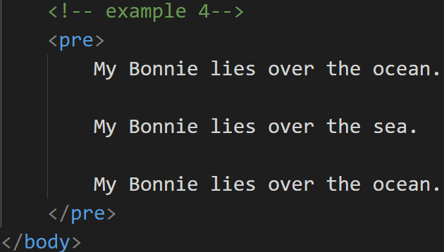
HTML Paragraphs
A paragraph <p> always starts on a new line, and is usually a block of text (example 1 ).
Browsers
automatically add some white space (a margin) before and after a paragraph.
The browser will automatically remove any extra spaces and lines when the page is displayed (example 2 ).
HTML Horizontal Rules: <hr> tag (example 3 ).
The <hr> tag is an empty tag which defines a thematic break in an HTML page to separate content in an HTML page
The HTML <br> element defines a line break (new line) without starting a new paragraph
The HTML <pre> element defines preformatted text which s displayed in a fixed-width font (usually Courier), and it preserves both spaces and line breaks (example 4)
Example 1 output
Example 2 output
Example 3 output
Example 4 output

Slide 15
Styles & Colors (1-2)
The HTML style attribute is used to add styles to an element, such as color, font, size, and more.
Style attribute syntax: <tagname style="property:value;">
The property is a CSS property. The value is a CSS value.
Examples:
Background Color: The CSS background-color property defines the background color for an HTML element.
<body style="background-color:powderblue;">
Text Color: The CSS color property defines the text color for an HTML element
<h1 style="color:red;">This is a red heading</h1>
Text Size using font-size property: <h1 style="font-size:300%;">This is a heading</h1>
Text Alignment: <h1 style="text-align:center;">Centered Heading</h1>

Slide 16
Styles & Colors (2-2)
HTML Colors:
Are specified with predefined color names, or with RGB (Red-Green-Blue), HEX (Hexadecimal, #rrggbb), HSL & HSLA(Hue-Saturation-Lightness/Alpha channel) values
Some color names: orange, tomato, gray, violet, …
HTML supports 140 standard color names
Colored border example:
<h1 style="border: 4px solid Tomato;">Hello World from HTML</h1>
Color values examples:
<p style="background-color: rgb(255, 99, 71);">Hello world </p>
<p style="background-color: #ff6347;">Hello world </p>
<p style="background-color: hsl(9, 100%, 64%);">Hello world </p>

Slide 17
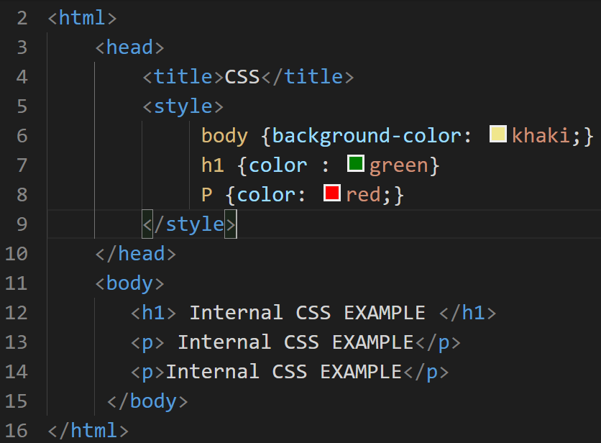
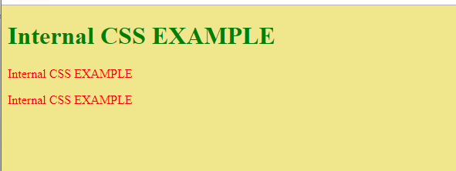
CSS (Cascading Style Sheets)
CSS:
Formats the layout of a webpage such as color, font, size of text, spacing, positions of elements,
Can control the layout of multiple pages at the once
“cascading” means that a style applied to a parent element will also apply to all children elements within the parent
Can be added to HTML document in 3 ways:
Inline: using the style attribute
Internal: using style element in <head> section (example)
External: using a <link> element to link to an external CSS file

Slide 18
Links (1-3)
Are found in nearly all web pages
Allow users to go from page to another one
HTML links are hyperlinks, so you can click on a link and jump to another document
Syntax: using the anchor tag <a href=“url”> link text </a>
href: indicated link destination
Example: <a href="www.w3schoosl.com">Go to W3School</a>
This example will display the w3school page in the same browser window
Target attribute: determines where to open the linked document ad have 4 values
_blank: new window or tab
<a href="www.w3school.com" target="_blank">Go to W3School</a>
_self: on the same window or tab
_parent: in the parent frame
_top: in the full body of the window

Slide 19
Links (2-3)
URL types:
Absolute URL: full web address like “http://www.w3schools.com/test.css”
Relative URL: local link (link to a page within the same website ) like “test.css” or “/css/test.css”
Link to Email address:
Use “mailto:” inside the the href attribute
Example: <a href="mailto:xyz@yahoo.com">Send email to xzy</a>
Link title:
Title attribute specifies extra information abount an elemnt
Example: <a href="www.w3schools.com/html/" title="Go to W3schools HTML"> HTML tutorial</a>
Using style tag to change the colors of the link when it is unnvisited, visited or active (W3schools)

Slide 20
Links (3-3)
Create a bookmark using link tag which helps when the web page is very long
When the link is clicked, the page will scroll down or up to the location with the bookmark
Steps:
Create a bookmark using the id attribute: <h1 id="ch8"> Chapter 8</h1>
Add a link to the bookmark from within the same page <a href="#ch8">Jump to chapter 8</a>

Slide 21
Images (1-3)
<img> is an Empty tag which embed an image in the html page
Syntax: <img src=“url” alt=“alternatetext”>
Src attribute: specifies the path (URL) to the image
Alt attribute: provide alternative text if the image does not loaded
Example: <img src="htmlcssjs.jpg" alt="HTML vs CSS VS JS"> or
<img src="E:\Faculty\webcourse\htmlcssjs.jpg" alt="HTML vs CSS VS JS">
Or <img src=“https://www.xyz.com/images/htmlcssjs.jpg" alt="HTML vs CSS VS JS">

Slide 22
Images (2-3)
Image size:
<img src="htmlcssjs.jpg" alt="HTML vs CSS VS JV" width="200" height="200">
<img src="htmlcssjs.jpg" alt="HTML vs CSS VS JV" style="width: 200px; height: 200px;">
<img src="htmlcssjs.jpg" alt="HTML vs CSS VS JV" style="float: left; width: 200px; height: 200px;">
Try animated images .gif extension
Image as link:
<a href="https://www.xyz.com"> <img src="htmlcssjs.jpg" alt="HTML vs CSS VS JV" style=" width: 200px; height: 200px;"> </a>

Slide 23
Images (3-3)
Background image:
Can be specified for almost any HTML
By the style attribute and the CSS background-image property
Example
<body style="background-image: url('htmlcssjs.jpg');"> </body>
<body style="background-image: url('htmlcssjs.jpg'); background-repeat: no-repeat;"> </body>
Try the <picture> element

Slide 24
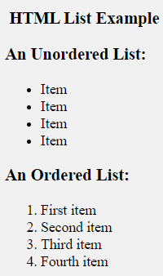
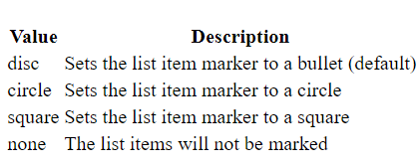
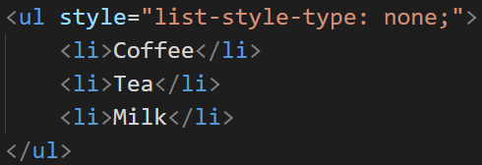
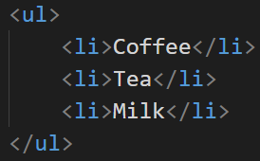
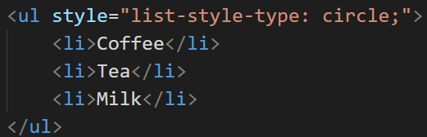
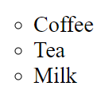


Lists
The <ul> & <ol> tags: create an unordered and ordered lists respectively
The <li> tag: creates each list item
The list items will be marked with bullets (small black circles) by default
The CSS list-style-type property is used to define the style of the list
item marker:
Examples

Slide 25
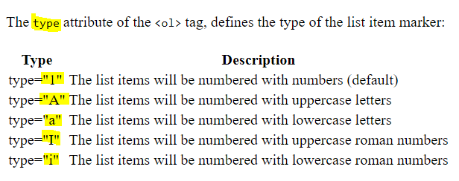
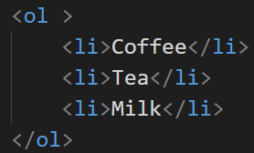
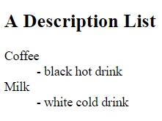
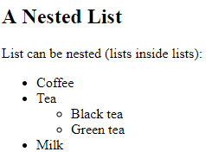
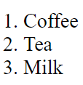

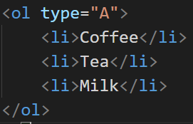
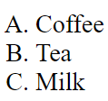

Lists
Using W3School, try the followings:
Ordered lists
Control lists
Horizontal lists

Slide 26
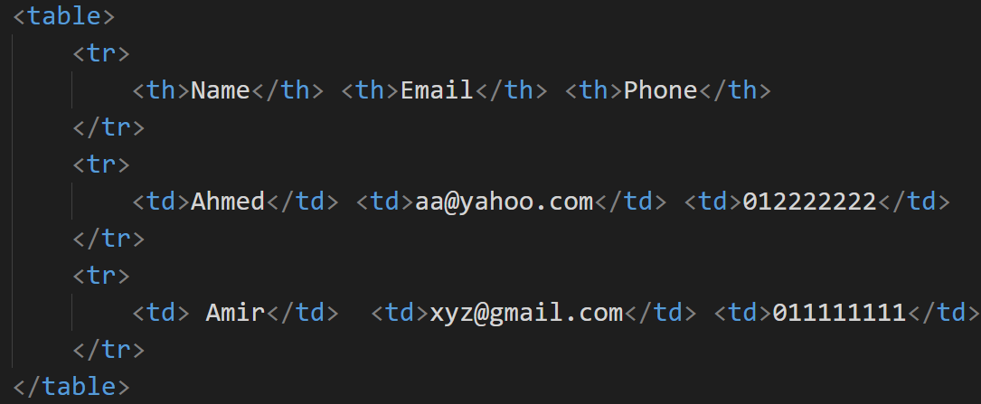
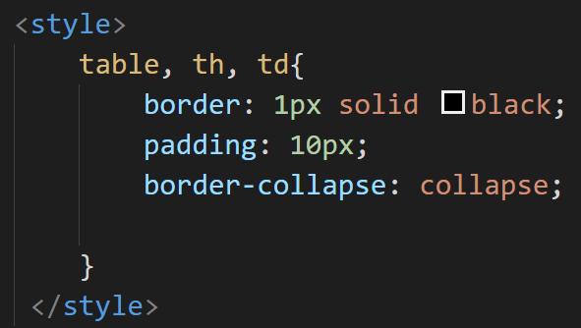
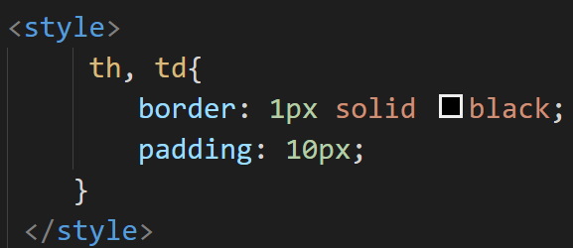
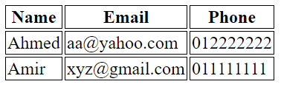
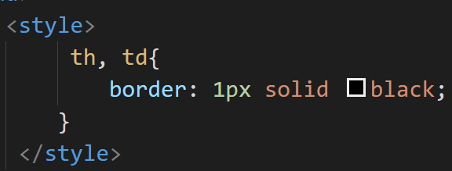
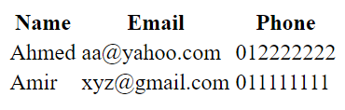
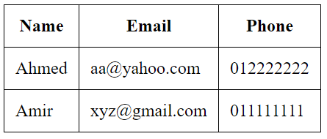
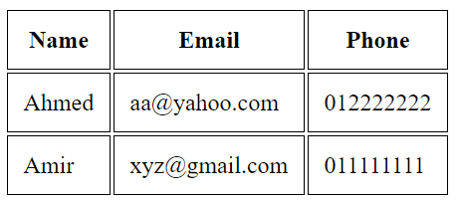
HTML Tables
Table formatting
HTML tables allow web developers to arrange data into rows and columns.
The <table> tag defines the HTML table
The <tr> tag defines each table row.
The <th> tag defines the table header.
The <td> tag defines the table data/cell.
By default, table headings are bold and centered
Examples
Other table formatting attributes:
The colspan attribute: make a cell span more than one column
The rowspan attribute: make a cell span more than one row
The <caption> tag: adds a caption to a table

Slide 27
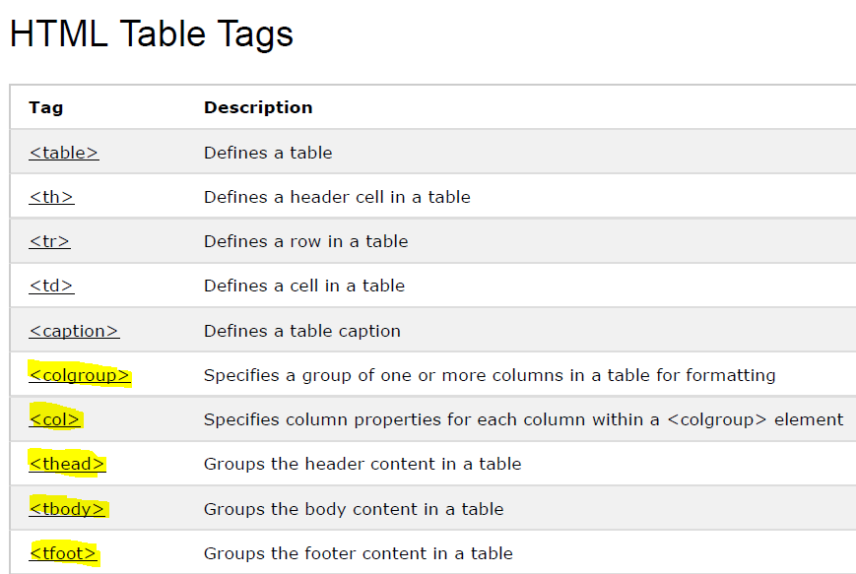



HTML Tables – more tags

Slide 28



Frames
The iframe tag allows to display/embed content coming from other web pages into your web page.
Syntax: <iframe src="url"></iframe>
Example

Slide 29



HTML Forms
The HTML form
is used to collect data or input from the user
Is defined by the <form> element
Syntax:
Example
HTML Form elements

Slide 30










<input> Element
Input elements syntax:
Describes the input data
displays the <input> element in several ways based on the value: text, button, radio, submit, checkbox, password, reset, color, date, datetime-local, email, month, number, range, search, tel, time, url, week
Examples:

Slide 31
<input> tag attributes
Other attributes:
Autocomplete
autofocus
form
formaction
formenctype
formmethod
formnovalidate
formtarget
height and width
list
min and max
multiple
pattern (regexp)
placeholder
required
step
<input> Element – attributes
Meaning | Input attribute
specifies the initial value for an input field | value
specifies that the input field is read only (cannot be changed) | readonly
specifies that the input field is disabled | disabled
pecifies the size (in characters) for the input field | size
pecifies the maximum allowed length for the input field | maxlength

Slide 32

Form attributes

Slide 33







Other Form Elements

Slide 34
class & id Attributes
The class attribute
specifies one or more class names for an HTML element.
The class name can be used by CSS and JavaScript to perform certain tasks for elements with the specified class name.
The id Attribute
specifies a unique id for an HTML element (the value must be unique within the HTML document).
The id value can be used by CSS and JavaScript to perform certain tasks for a unique element with the specified id value.

Slide 35

<head> Element (1-2)
The <head> element
is a container for metadata (data about data) and is placed between the <html> tag and the <body> tag.
HTML metadata is data about the HTML document. Metadata is not displayed.
Metadata typically define the document title, character set, styles, links, scripts, and other meta information.
The following tags describe metadata: <title>, <style>, <meta>, <link>, <script>, and <base>.
The <link> element is used to link to external style sheets
<link rel="stylesheet" href="mystyle.css">
The <meta> element is used to specify which character set is used, page description, keywords, author, and other metadata.

Slide 36
<head> Element (2-2)
The <base> element specifies the base URL and base target for all relative URLs in a page: <base href="https://www.w3schools.com/images/" target="_blank">
The <script> element is used to define client-side JavaScripts.
JavaScript example on the next slide

Slide 37

HTML Layouts
Websites often display content in multiple columns (like a magazine or newspaper).
There are four different ways to create multicolumn layouts:
HTML tables (not recommended)
CSS framework: fast, like Bootstrap.
CSS float property
CSS flexbox: is a new layout mode in CSS3
HTML5 offers new semantic elements that define the different parts of a web page:
View and test the examples at W3schools

Slide 38

HTML Responsive Web Design
Responsive Web Design is about using HTML and CSS to automatically resize, hide, shrink, or enlarge, a website, to make it look good on all devices (deskops, tablets, and phones):
To make responsive website use (try the full example at w3schools):
<meta name="viewport" content="width=device-width, initial-scale=1.0">
You should also make responsive: images, text size

Slide 39
HTML Graphics
Graphics can be drawn by <canvas> and <svg> tags
The <canvas> tag:
has several methods for drawing paths, boxes, circles, text, and adding images.
is only a container for graphics
So, you must use JavaScript to actually draw the graphics
The canvas:
Is rectangular area on an HTML page.
By default, a canvas has no border and no content.
<canvas> tag syntax:

Slide 40






<canvas> Examples
Try to draw: text, linear gradient, …

Slide 41



Graphic using SVG
SVG
stands for Scalable Vector Graphics
is used to define graphics for the Web
is a W3C recommendation
The HTML <svg> element is a container for SVG graphics.
has several methods for drawing paths, boxes, circles, text, and graphic images.
Examples
Try to draw: circle, star, rectangle, logo

Slide 42

Canvas vs. SVG
HTML Google Maps: try its code from the W3schools (need internet)

Slide 43
HTML Media
Multimedia on the web is Images, music, sound, videos, records, films, animations, and more.
Multimedia comes in many different formats
Multimedia files have formats and different extensions like: .swf, .wav, .mp3, .mp4, .mpg, .wmv, and .avi.
Note: visit the W3schools and read the various formats for each media type.

Slide 44



HTML Media – video
Before HTML5, a video could only be played in a browser with a plug-in (like flash).
The HTML5 <video> element specifies a standard way to embed a video in a web page.
In HTML5, there are 3 supported video formats: MP4, WebM, and Ogg.
Video Media types:
Examples

Slide 45



HTML Media – audio
Before HTML5, audio files could only be played in a browser with a plug-in (like flash).
The HTML5 <audio> element specifies a standard way to embed audio in a web page.
Audio media types
In HTML5, there are 3 supported audio formats: MP3, Wav, and Ogg.
Example

Slide 46
HTML Media – Plug-ins
Plus-ins (helper applications):
are computer programs that extend the standard functionality of a web browser and can be used for many purposes: display maps, scan for viruses, verify your bank id, etc.
Examples of well-known plug-ins are Java applets.
can be added to web pages with the <object> tag or the <embed> tag.
The <object> Element
is supported by all browsers.
defines an embedded object within an HTML document.
is used to embed plug-ins (like Java applets, PDF readers, Flash Players) in web page
Example

Slide 47
HTML Media – Plug-ins
The <embed> Element
An empty tag
Similar to <object> tag
Try examples from the w3school
HTML YouTube Videos
Try , using w3schools, how to play YouTube videos on an HTML web page

Slide 48



HTML JavaScript
JavaScript makes HTML pages more dynamic and interactive.
Common uses for JavaScript are image manipulation, form validation, and dynamic changes of content.
The HTML <script> Tag
is used to define a client-side script (JavaScript).
The <script> element either contains scripting statements, or it points to an external script file through the src attribute.
To select an HTML element, JavaScript very often uses the document.getElementById() method.

Slide 49


HTML Text Formatting
Formatting elements were designed to display special types of text:
Tag Output:

Slide 50
Quotations, comments
To add a comment in HTML you use: <!-- a basic comment -->
Quotations tags:
<blockquote> tag: defines a section that is quoted from another source and the browser indents it
<blockquote>HTML was officially born in 1993</blockquote>
<q> tag: for inline and short quotation
<p>This is inline quote for <q>HTML was officially born in 1993</q></p>
<abbr> tag: define abbreviations or acronym like “DB”, “HTML”, “CS”, “Dr.”, etc.
<p>The <abbr title="Hypertext Markup Language"> HTML</abbr> is base of any website.</p>
<address> tag: defines contact information like email address, URL, phone number, etc.
The browser will add a line break before and after plus rendering address in italic
<cite> tag: define the title of a creative work like book, song, movie, …
Renders in italic
<bdo> tag: “Bi-Directional Override” changes writing direction
<bdo dir="rtl"> write from right to left</bdo>

Slide 51




HTML Block and Inline Elements
The default display value for most elements is block or inline.
Block-level Elements (look at other block-level elements at w3schools e.g., <ol>, <pre>, …. )
Always start on a new line and takes up the full width available (stretches out to the left and right as far as it can).
The <div> element is a block-level element.
An inline element: . (look at other inline-level elements at w3schools, e.g., <a>, <b>, <q>, …)
does not start on a new line and only takes up as much width as necessary.
This is an inline <span> element inside a paragraph.

Slide 52








HTML Computer Code Elements

Slide 53





HTML Entities
Character entities are used to display reserved characters in HTML.
Some characters are reserved in HTML.
So, If you use the less than (<) or greater than (>) signs in your text, the browser might mix them with tags.
A character entity looks like this:
A common character entity used in HTML is the non-breaking space: &nbsp;
A non-breaking space is a space that will not break into a new line.
To display a less than sign (<) we must write: &lt; or &#60;

Slide 54





HTML Symbols
Many mathematical, technical, and currency symbols, are not present on a normal keyboard.
To add such symbols to an HTML page, you can use an HTML entity name.
If no entity name exists, you can use an entity number, a decimal, or hexadecimal reference.
Symbol examples

Slide 55
Read more about (W3Schools)
HTML Encoding (Character Sets)
HTML Uniform Resource Locators (URL)
HTML and XHTML

Slide 56
HTML APIs
Try these APIs from the W3Schools (HTML 5)
Geolocation: for locating user position
Drag and Drop: is when you "grab" an object and drag it to a different location.
Web Storage: web applications can store data locally within the user's browser.
Web Workers: web worker is a JavaScript running in the background, without affecting the performance of the page.
Server-Sent Events: allow a web page to get updates from a server.

Slide 57
Resources
W3school website is the main source of learning for HTML, CSS, JavaScript
For HTML visit: https://www.w3schools.com/html/default.asp

Slide 58

Task 1
How to submit?
Upload the task on Github
Submit the task link to me (Google class
room task 1)

Slide 59

Thanks

